Slide 1


How to Create Raving Fans
And Endless Reoccurring Revenue

Slide 2
Strategical
Tactical

Slide 3
I Care About You!

Slide 4
Shiny Object
Syndrome

Slide 6
4x – 12x MORE

Slide 7
Raving Fans
Endless
Reoccurring
Revenue
Notes:
SEXY, FUN, GEEK OUT on this ---------- THE BS Meter is so HIGH these days.

Slide 8
Direct Mail
Handwritten Notes
Books
Notes:
SEXY, FUN, GEEK OUT on this ---------- THE BS Meter is so HIGH these days.

Slide 9
SURPRISE!!!!

Slide 10
D I f f E r E n T
BE

Slide 11
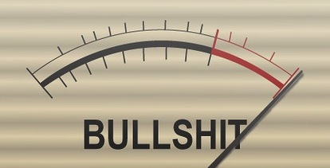

Slide 12
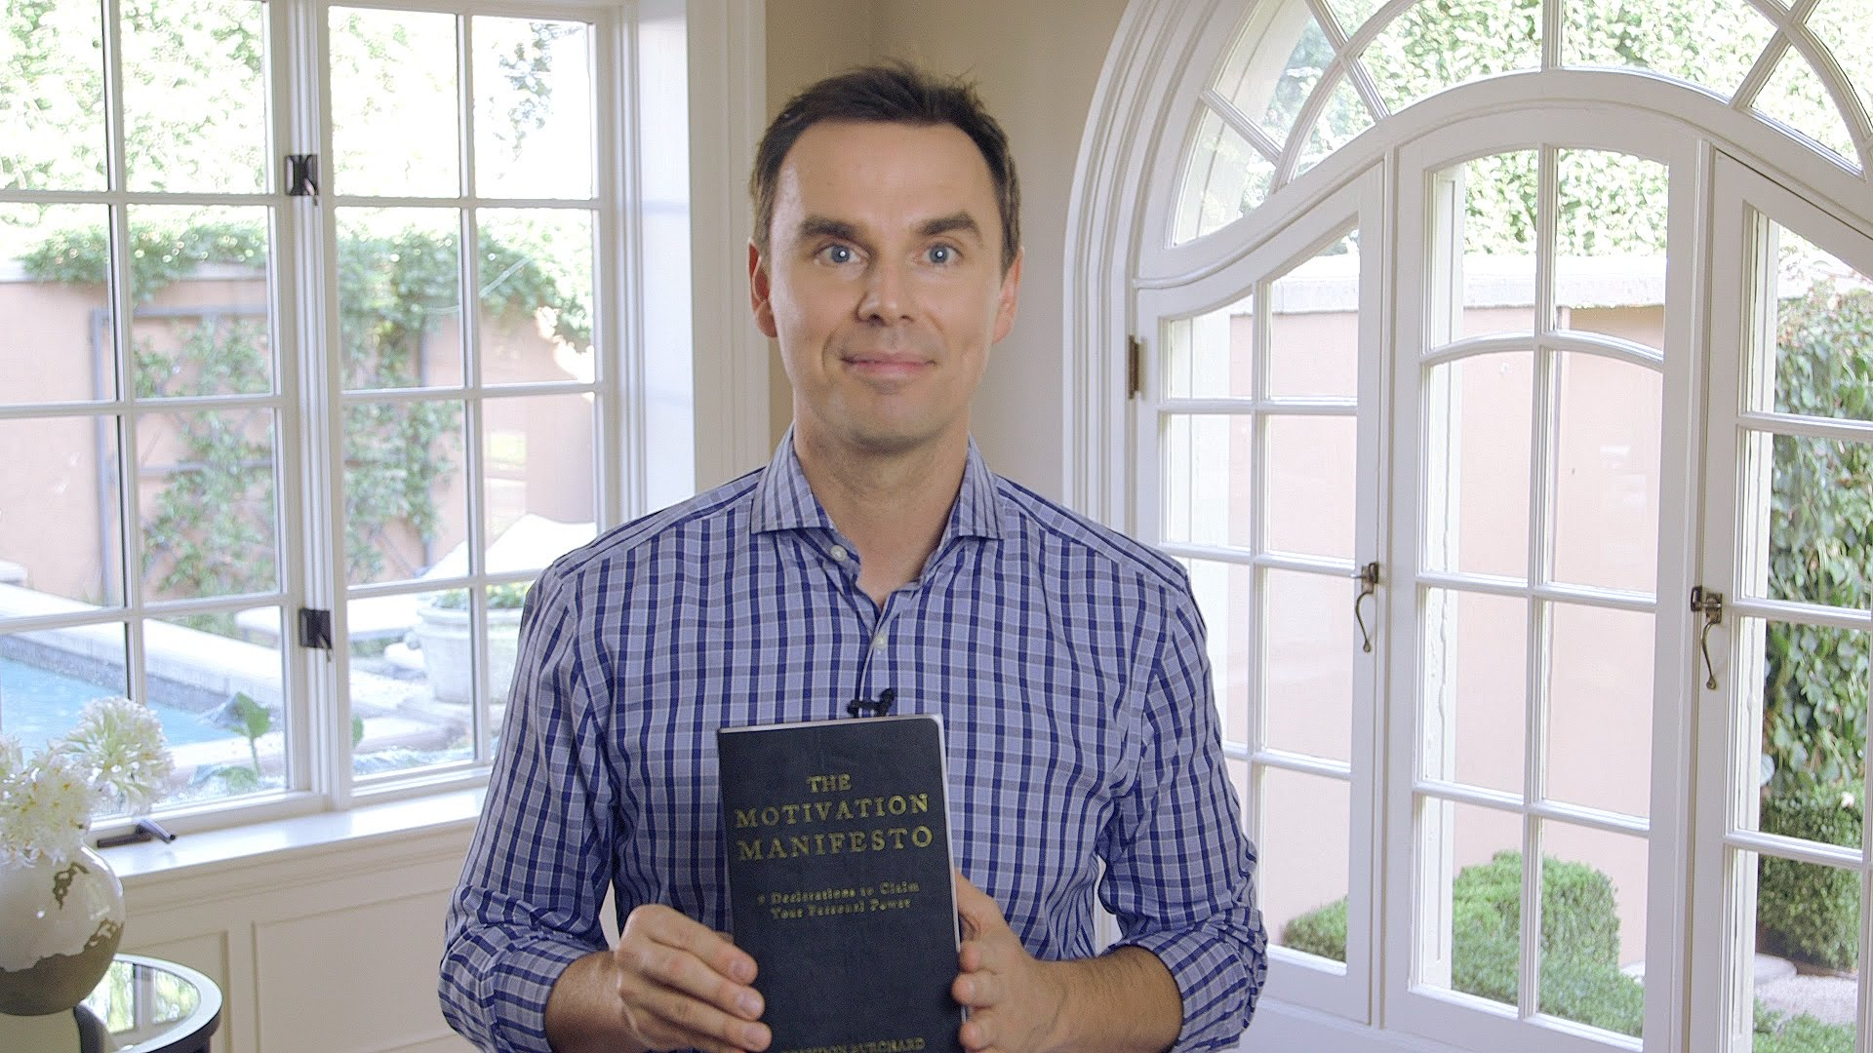
-Raving fans
-Offline engagement -- hours of their time not seconds
⁃DR - Send other people's books or products
⁃Good messaging
⁃They will always open the package
⁃Millennials love packages
⁃Every time they see that book they will think about y
Front End Marketing
1 Member
Postcards
- Sales Letters
- DR insert BS METER GRAPHIC

Slide 14
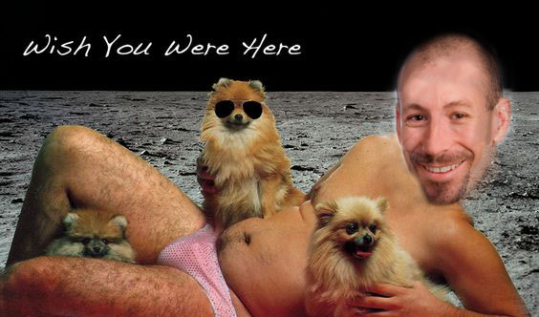
-Raving fans
-Offline engagement -- hours of their time not seconds
⁃DR - Send other people's books or products
⁃Good messaging
⁃They will always open the package
⁃Millennials love packages
⁃Every time they see that book they will think about y
Front End Marketing
Postcards
Sales Letters

Slide 15
Handwritten Notes
Time Consuming

Slide 16
10,000

Slide 17
Rapport

Slide 18
Printer

Slide 19
The Ultimate Value Add
Books

Slide 20
THROW THE
EGO OUT!
Notes:
SEXY, FUN, GEEK OUT on this ---------- THE BS Meter is so HIGH these days.

Slide 21
I CARE ABOUT
YOU!
Notes:
SEXY, FUN, GEEK OUT on this ---------- THE BS Meter is so HIGH these days.

Slide 22


Slide 23
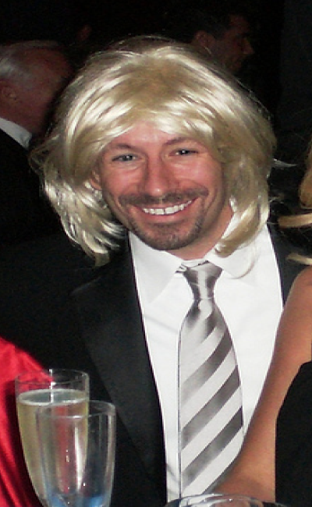

Slide 24


Slide 25

Draye25k.com

